Slide 1




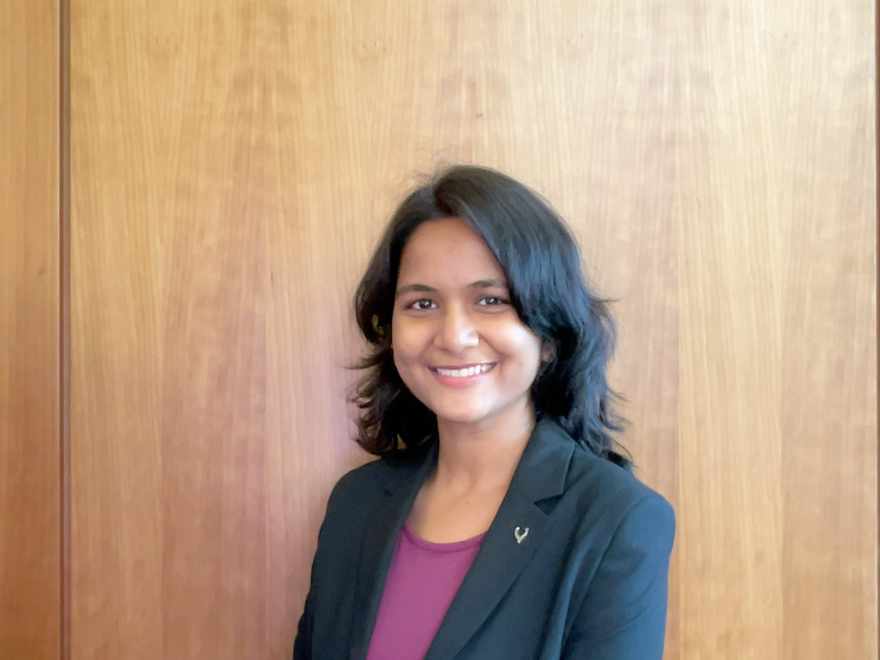

Management of Organizational Data
Darshan App A key to pious India
Vishnu Vardhan Ponduri
Sathwik Kanukuntla
Priya Sharma
Rohit Mittal
Pooja Udayanjali Kannuri
Pawan Santosh Kurada

Slide 2
Contents
Background
Introduction
Objective
Entity Relationship Diagram
Relational Schema
Database Implementation
Queries on SQL
Q&A
https://darashan.com/

Slide 3
Background
Darshan App: A Beacon of Knowledge for the Spiritually Inclined
Darshan is a spiritual app that caters to the needs of individuals on their spiritual journey. It offers a rich array of resources, such as deity directories, festival calendars, and access to sacred scriptures. As a comprehensive platform, it empowers devotees by providing them with valuable information and tools to enhance their spiritual experiences.
However, despite its valuable content and intentions, Darshan is facing a significant challenge in its current database system. This system, which has been in use, needs to better equip to be capable of meeting the growing demands and complexities of the app's data requirements. The database has become inefficient and struggles to handle the increasing volume of information and user interactions.
This limitation in the database system is adversely affecting Darshan's ability to offer a seamless and user-centric experience to its audience. Users may encounter delays, errors, or difficulties in accessing the information they seek. To maintain and enhance its position as a reliable spiritual resource, Darshan is in need of an upgraded database system that can efficiently manage its expanding data and deliver a smoother experience to its users.

Slide 4

Background
The Need for a New Database
The paradigm shift toward a more expansive and holistic approach to spiritual enlightenment necessitates a database solution that can mirror this transformation. The comprehensive resources that Darshan provides to its users demand a far more sophisticated and versatile database management system.
Connect the various gods, festivals, and scriptures
Provide important information on each of them
Be dynamic and allow devotees to add their own directory
Be structured in a way that allows the company to answer the most commonly asked questions and queries at a moment's notice
Improve the user experience
Increase SEO
Enable Darshan to develop new features
A new database is essential for Darshan to continue to grow and serve its users effectively. The new database will allow Darshan to offer a more seamless and user-centric experience, improve its SEO, and develop new features.

Slide 5
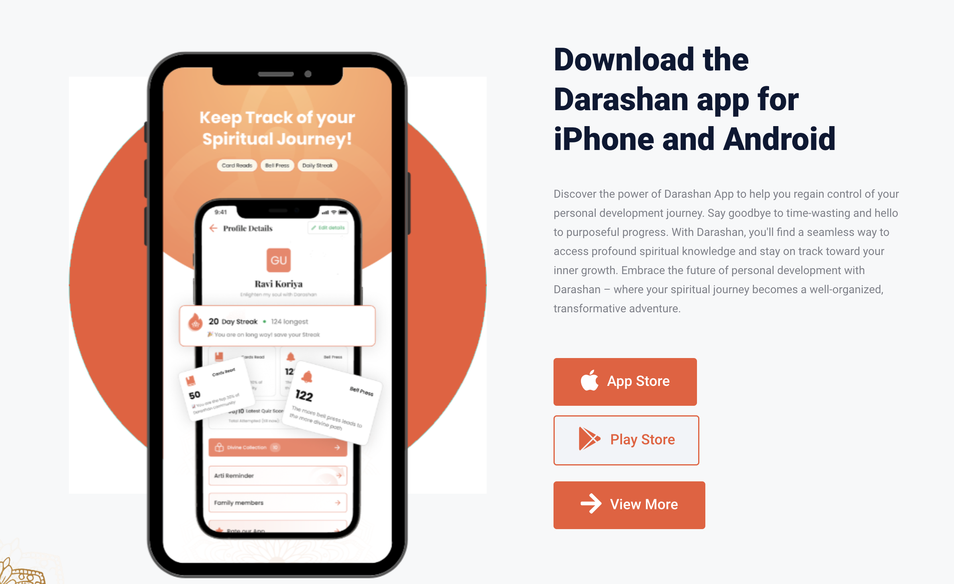
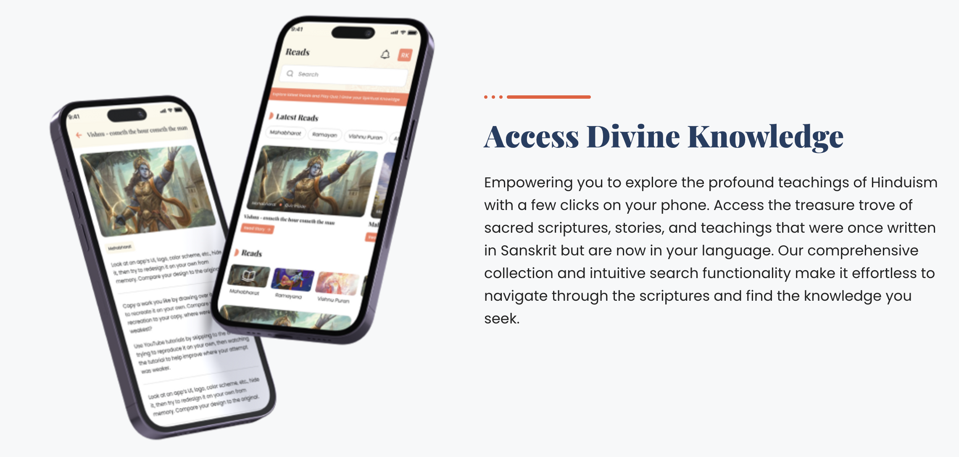
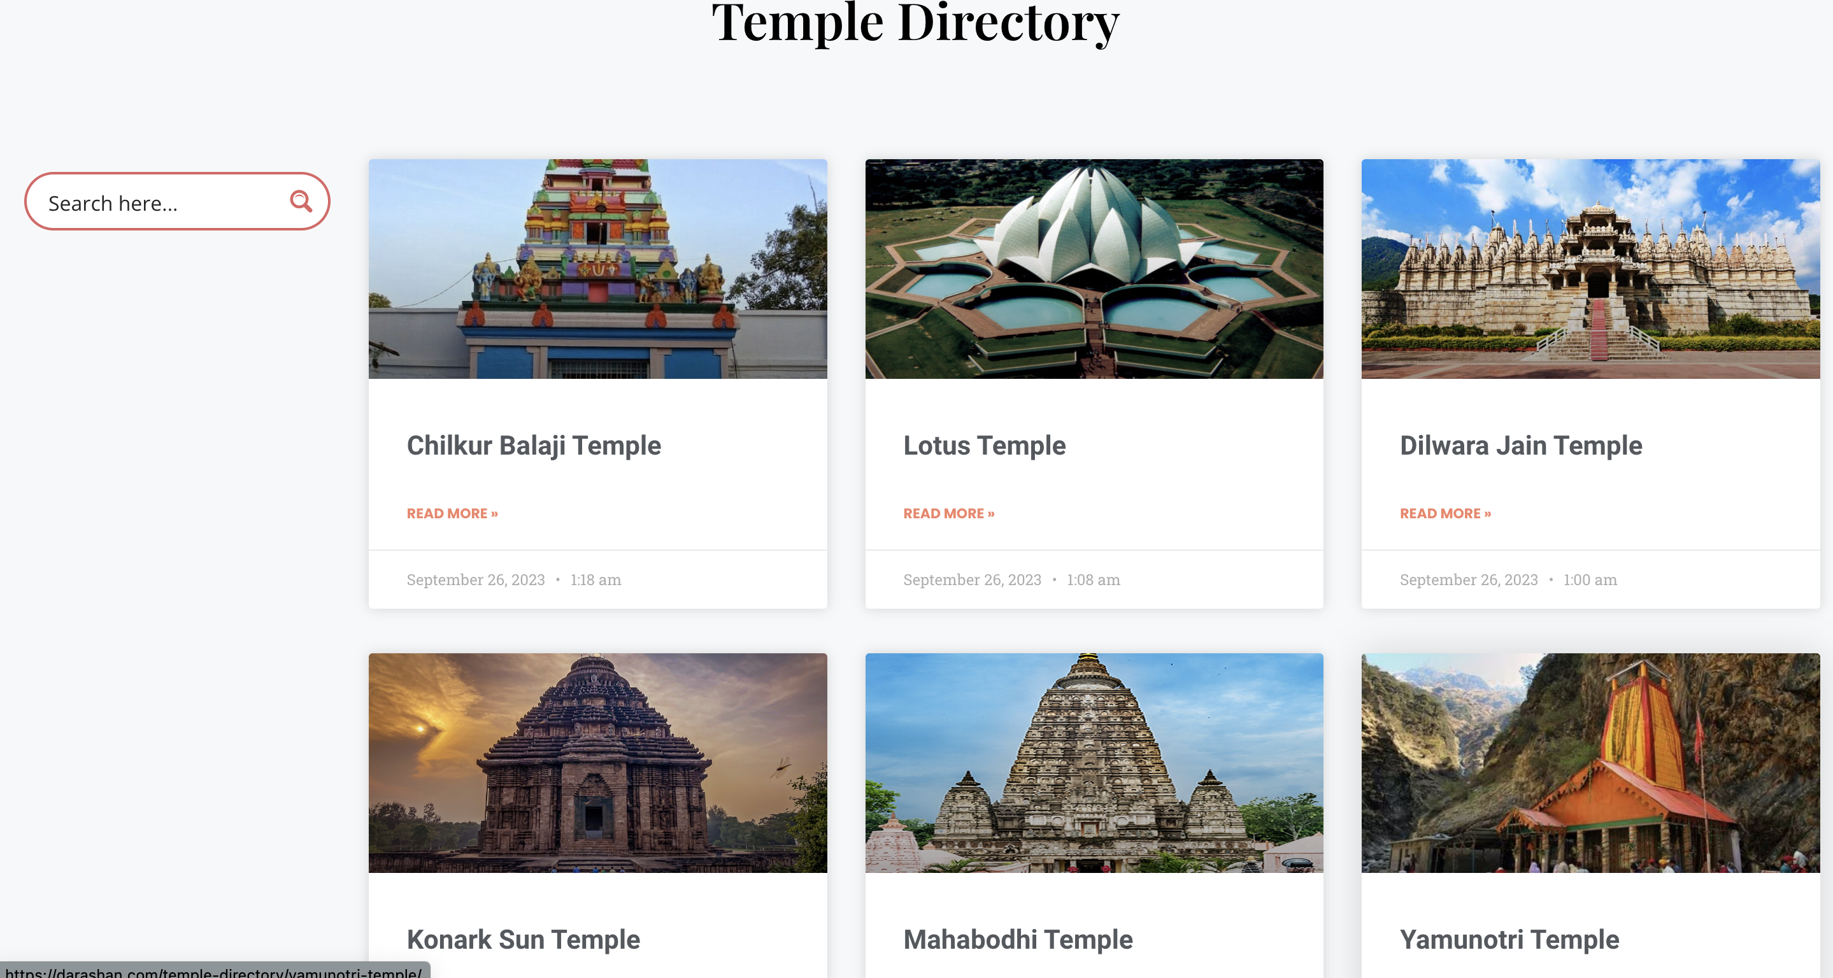
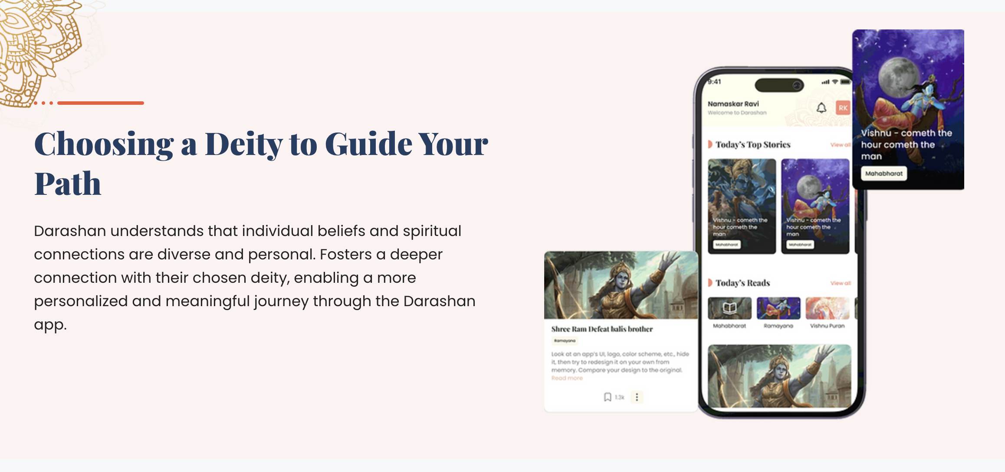
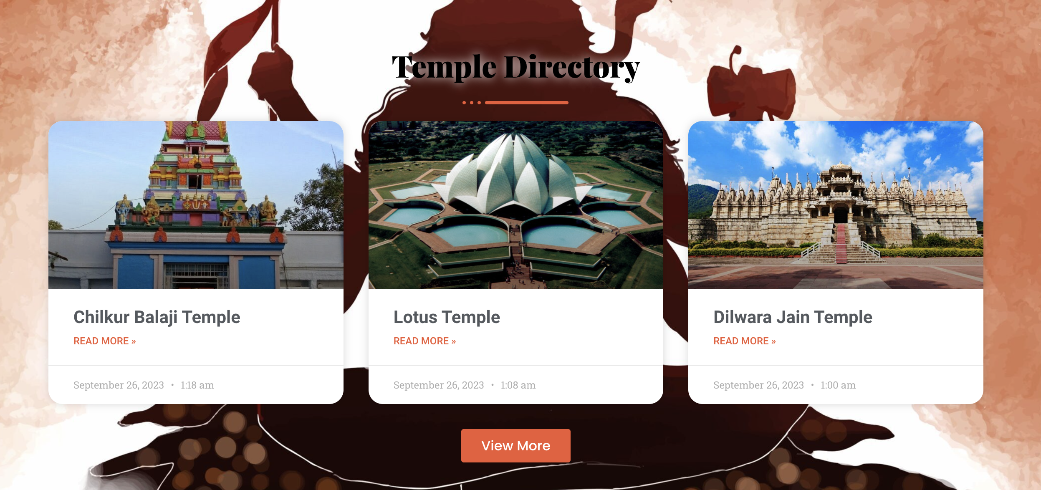

Slide 6
Introduction
Darshan is a spiritual app that provides users with a variety of resources, including deity directories, festival calendars, and sacred scriptures. The current database system, which is primarily reliant on Microsoft Excel, is no longer adequate to meet the needs of Darshan. The system is inefficient and unable to handle the growing volume and complexity of data. This is preventing Darshan from offering a seamless and user-centric experience.
The objective of this project is to develop a structured database that connects the various gods, festivals, and scriptures and provides important information on each of them. This database will be dynamic and allow devotees to add their own directory. It will also be structured in a way that allows the company to answer the most commonly asked questions and queries at a moment's notice.

Slide 7
Objective
The new database will benefit Darshan in numerous ways:
Improved user experience: The database will allow Darshan to offer a more seamless and user-centric experience. Devotees will be able to easily find the information they need, such as the dates of upcoming festivals, the locations of temples, and the contents of sacred scriptures.
Increased SEO: Darshan can use the database to improve its SEO ranking. For example, when Darshan writes about a temple or god, it can include information about related festivals, puranas, and other scriptures. This will make the Darshan website more informative and relevant to search engine users.
New features: The database will enable Darshan to develop new features, such as a festival calendar and a push notification system. Devotees can use the festival calendar to track upcoming festivals and receive push notifications about important events.

Slide 8
Objective
The potential of a robust and versatile database for Darshan goes beyond just efficient data management. It can revolutionize the way the platform serves its users.
Personalized Recommendations: With a new database, Darshan can implement personalized recommendation systems. It could suggest relevant festivals for devotees to attend based on their interests, location, or previous engagements, making it more tailored and engaging.
Knowledge Base of Spiritual Wisdom: It can serve as the foundation for a comprehensive knowledge base of spiritual wisdom for creating informative articles, engaging videos, and other educational content. This content can help users deepen their understanding of their faith and spirituality, fostering a deeper connection.
Community Forum: A database upgrade can also enable the creation of a vibrant community forum within the app. Devotees can connect with each other, share their spiritual experiences, seek advice, and engage in meaningful discussions

Slide 9
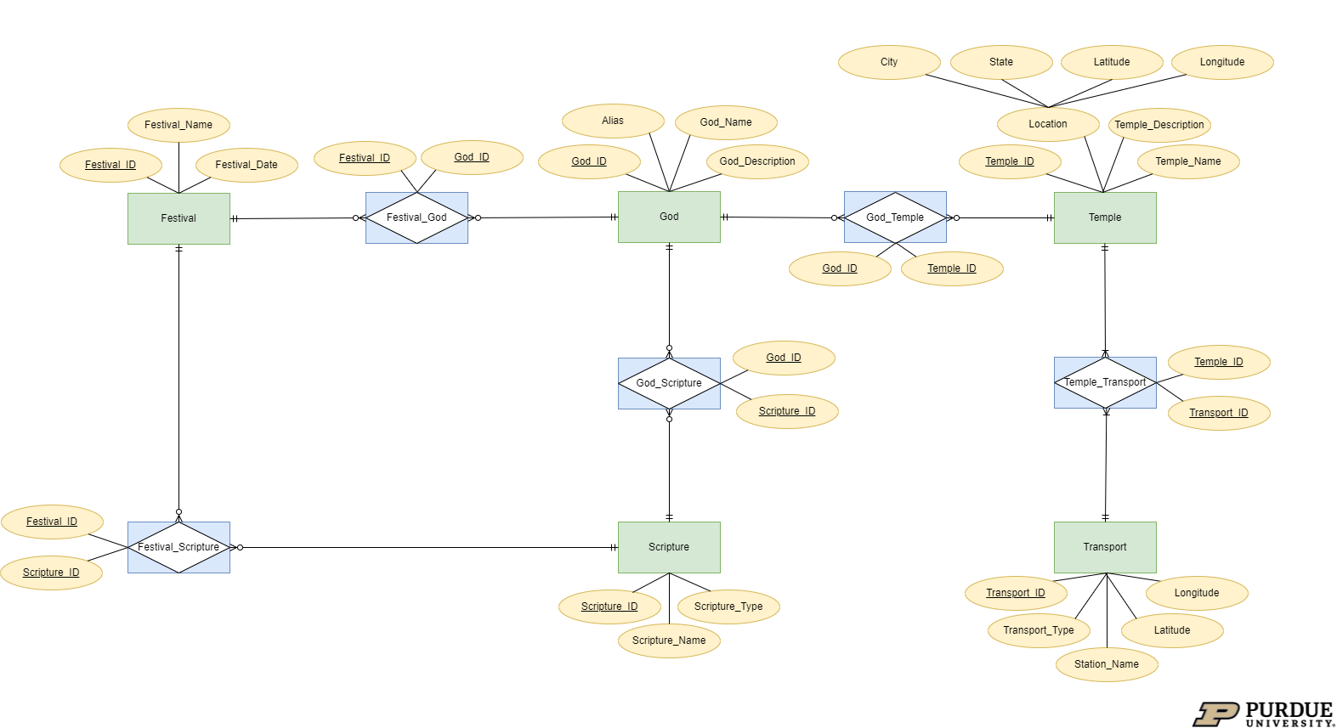
Entity Relationship Diagram

Slide 10
Understanding the Entity Relationship Diagram
The attached ERD (Entity-Relationship Diagram) is a visual representation of the relationships between the following:
Temple
Festival
Scripture
God
Transport
The relationships between the entities are as follows:
A festival can have many scriptures
A scripture can be associated with many festivals
A temple can have many gods
A god can be associated with many temples
A festival can celebrate a lot of gods
A god can be celebrated in various festivals
A god can be associated with many scriptures
A scripture can be associated with many gods
A temple can be reached by various transport options
A transport station can be the starting point of many temples
Entities
God Temple
God Scripture
Festival God
Festival Scripture
Temple Transport
Associative Entities

Slide 11
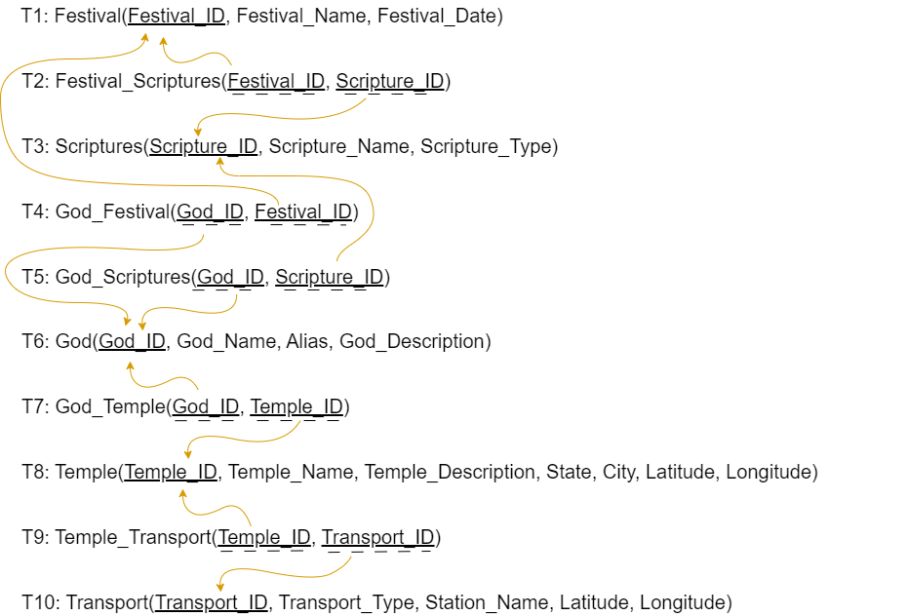
Relational Schema
The image presents a clear and concise representation of the relational schema, complete with referential integrity constraints and functional dependencies.
This schema serves as a foundational blueprint for organizing and structuring the database, ensuring that data relationships are maintained with precision and accuracy.
The Referential integrity constraints guarantee the consistency and reliability of data by enforcing rules that govern the relationships between tables, while functional dependencies provide valuable insights into how attributes within the schema relate to one another.

Slide 12
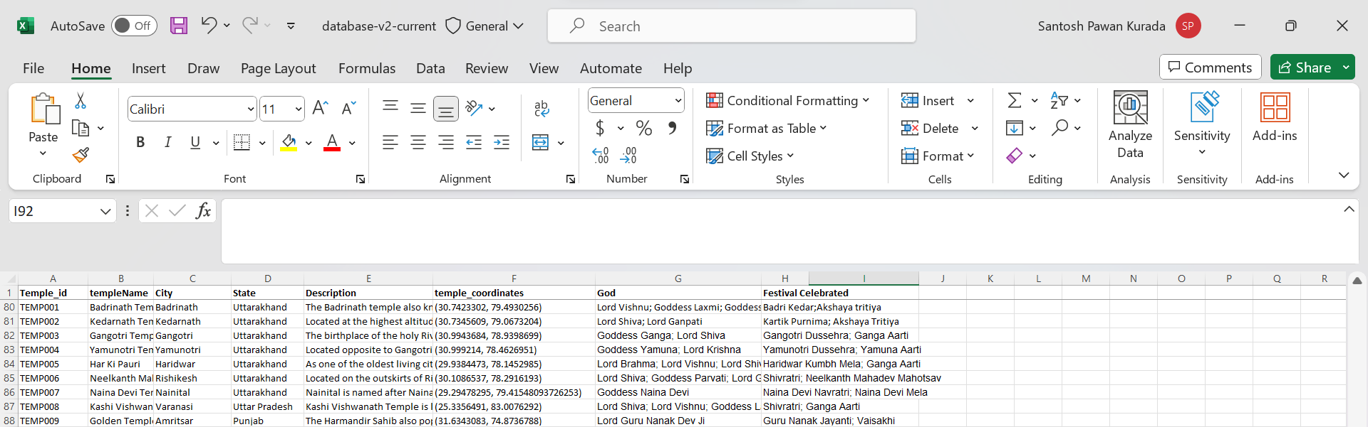
Database Design Technique (1/3)
Below is a snippet of the data that we received from our client.
Table in 0 NF
It can be observed that the data is in 0 NF because the God, Festivals Celebrated and temple coordinates have more than one value for each tuple. So, we break down the table to achieve 1 NF.

Slide 13
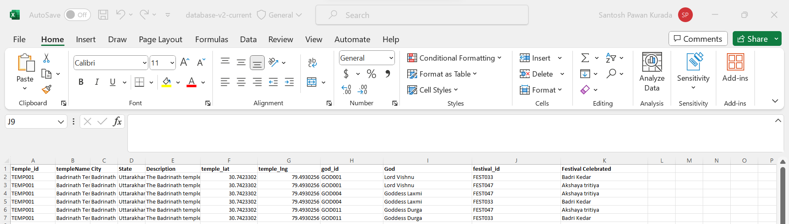
Database Design Technique (2/3)
Post normalizing the tables into 1NF, we checked for 3NF meeting criteria
Table in 1NF
All tuples in this table are strictly indivisible and there are no partial dependencies, however, there are some transitive functional dependencies that need to be eliminated to achieve 3NF.
Functional dependencies
Temple_ID → Temple_Name, City, State, Description, Temple_Lat, Temple_Lng, God_ID, Festival_ID
Festival_Id → Fest_Name
God_Id → God_Name

Slide 14

Database Design Technique (3/3)
After breaking down the temples to achieve 3 NF and the final relational schema is as below:

Slide 15

Database Implementation
We imported the database from Excel we formed by our research into MySQL without manually creating tables using the Import Data Wizard, follow these steps:
Access Import Data Wizard: In MySQL Workbench, navigate to the "Server" menu, select "Data Import," and choose "Import from Self-Contained File.”
Select Excel File: Selected the temple directory Excel file
Specified Target Schema and Database: Choose the target schema and database where you want to import the data, or create new ones as needed.
Map Columns and Configure Options: Mapped the columns in our Excel file to the MySQL table, ensuring proper data type alignment. Configure advanced options like handling duplicates, character encoding, and more.
Then, initiated the data import process.

Slide 16

Example of a Simple Use Case Avid Traveller's Spiritual Expedition to India: A Journey of Discovery
Imagine yourself, an avid traveller, embarking on a spiritual expedition to India, the land of ancient civilizations and diverse cultures. Your heart beats with eager anticipation as you step off the plane, welcomed by the warm embrace of the Indian subcontinent.
Your quest is to delve deep into the rich tapestry of Hindu culture, gaining profound insights into the myriad deities, exploring the sacred temples that serve as their abodes, and uncovering the diverse festivals celebrated at these holy sites.

Slide 17
Queries

Slide 18
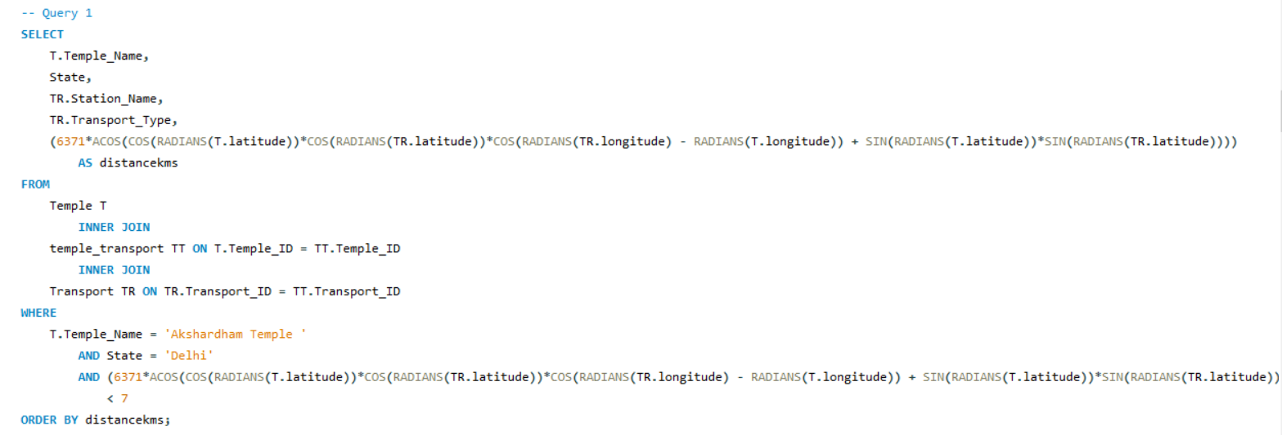
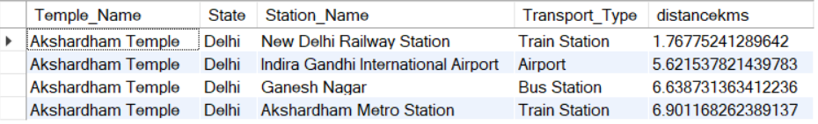

SQL Query 1 – What are the different transport stations near Akshardham temple in Delhi within 7km radium and what’s their distance from the temple is ascending order?
This SQL query extracts details about transport stations located within a 7-kilometer radius of Akshardham Temple in Delhi. It focuses on finding the nearest stations to the temple, ordering them by distance in ascending order.
Ultimately, this helps our traveller with a concise list of transport stations near the temple, sorted by their proximity to the sacred site.

Slide 19
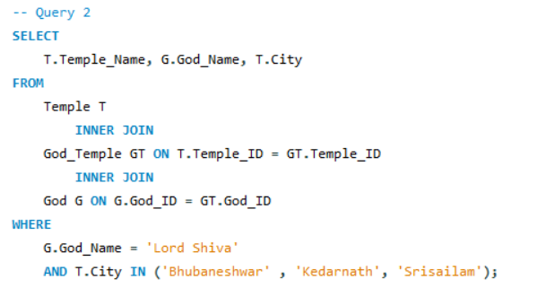

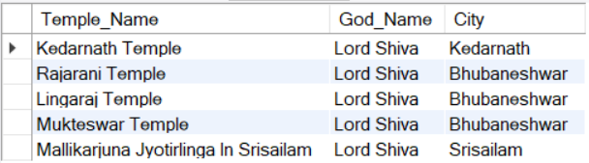
SQL Query 2 – What are all the temples the traveller can visit to get a darshan of Lord Shiva in these cities: 'Bhubaneshwar', 'Kedarnath', 'Srisailam'?
This query retrieves a list of temples where the traveller can seek the darshan (blessed sight) of Lord Shiva in the specified cities: 'Bhubaneshwar,' 'Kedarnath,' and 'Srisailam’. It accomplishes this by joining data from the "Temple," "God_Temple," and "God" tables, focusing on the deity 'Lord Shiva.'.

Slide 20
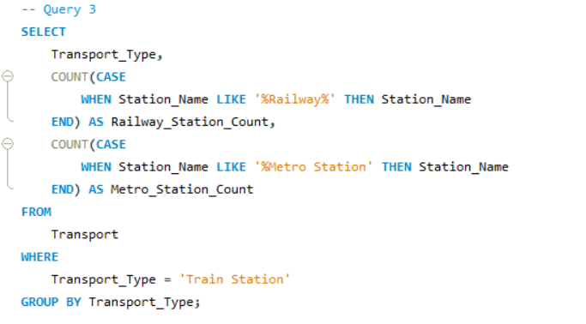

SQL Query 3 – Help the traveller filter between Railway station vs Metro station to reach a particular temple
This query assists the traveller in deciding between railway stations and metro stations when planning their journey to a particular temple. It counts the number of stations falling under each category and focuses on the 'Train Station' transport type. By presenting a clear count of railway and metro stations, the query enables travelers to make informed choices regarding their transportation options for reaching the temple.

Slide 21
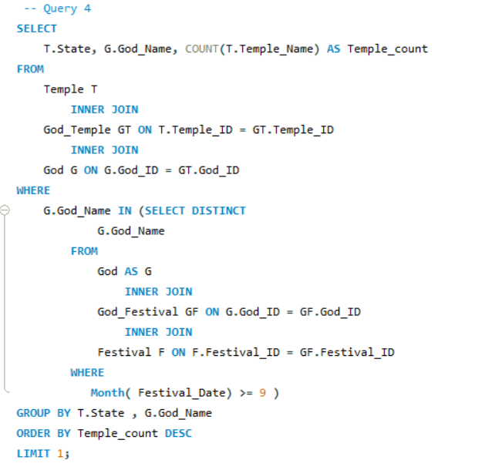

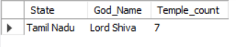
SQL Query 4 – To see the maximum number no of temples in a region dedicated to a god, when the traveller is attending a festival after September
This query serves to determine the region with the highest number of temples dedicated to a specific god when the traveller is planning to attend a festival after September. It accomplishes this by counting the temples devoted to the chosen deity within each state, considering festival timings. The results are then sorted in descending order of temple count, revealing the region with the most temples for the traveller to explore.

Slide 22
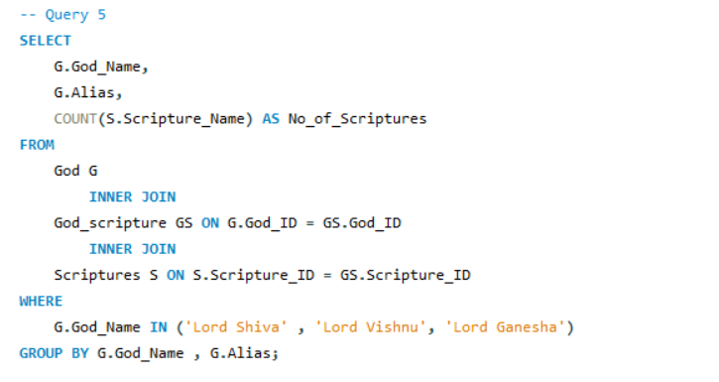

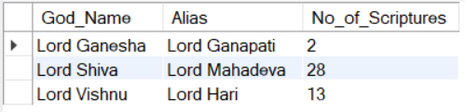
SQL Query 5 – The traveller wants to know are there any other names Lord Shiva, Lord Vishnu and Lord Ganapathi are referred by and how many scriptures associated with these gods for better understanding?
This query assists the traveller in discovering alternative names for Lord Shiva, Lord Vishnu, and Lord Ganapati while also providing insights into the number of scriptures associated with these deities. This information enriches the traveller's understanding of these revered deities and their references in various scriptures, making it easier to explore their diverse aspects and significance.

Slide 23
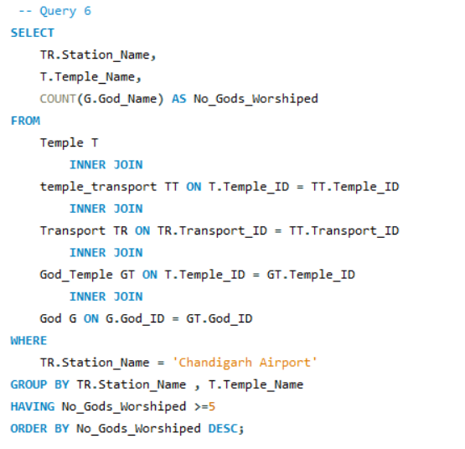

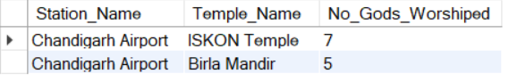
SQL Query 6 – The traveller wants to see if there are other temples you can visit from Chandigarh airport where he can worship more than 5 gods at these temples
This query aids the traveller in identifying temples in proximity to Chandigarh Airport, where they can engage in worship of more than five different gods. By connecting data from multiple tables, including "Temple," "Temple_Transport,” "Transport," "God_Temple," and "God," the query establishes links between temples, modes of transportation, gods, and their worship practices. It narrows down the results to temples near Chandigarh Airport, ensuring convenient access for travellers.

Slide 24

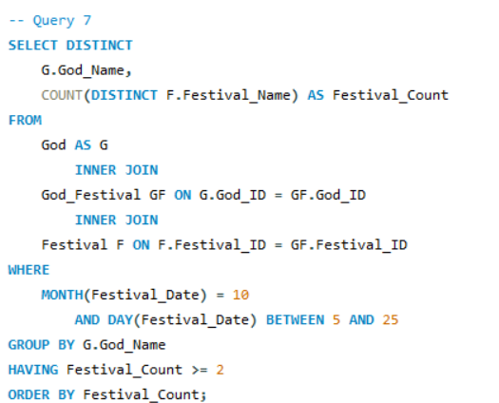
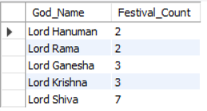
SQL Query 7 – The traveller wants to know which gods will have at least 2 festivals if he visits between 5th and 25th of the October
This query assists the traveller in identifying gods associated with at least two festivals that coincide with a visit between the 5th and 25th of October. The query focuses on festivals occurring within the month of October and between the specified date range. After grouping the results by god name, it filters out gods with fewer than two festivals. The query finally presents the results in ascending order of festival count, revealing the deities with multiple festivals during the traveller's intended visit period.

Slide 25

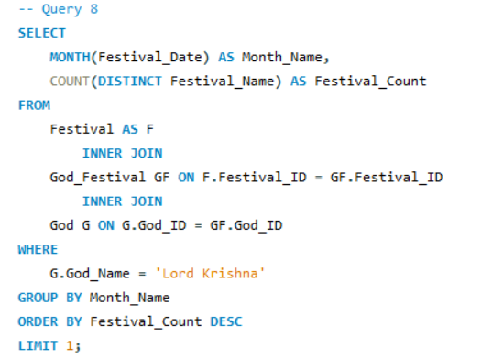
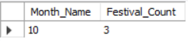
SQL Query 8 – A traveller seeks to determine the month with the most festivals dedicated to Lord Krishna to plan their travel schedule accordingly.
This query assists the traveller in pinpointing the month with the highest number of festivals dedicated to Lord Krishna, aiding them in planning their travel schedule accordingly. Armed with this insight, the traveller can align their visit to immerse in the vibrant festivities and spiritual experiences associated with Lord Krishna during the peak festival month.

Slide 26
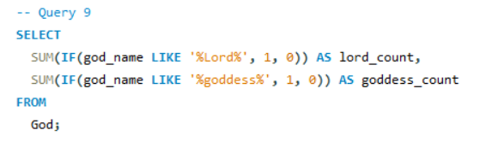
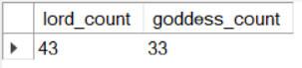

SQL Query 9 – Out of curiosity the traveller wants to know the Total Number Gods and Goddesses in India
This query serves the traveller's curiosity by calculating the total number of gods and goddesses in India. It achieves this by distinguishing between male deities with names ending in '%Lord' and female deities with names containing 'goddess.' Drawing data from the "God" table, the query provides a comprehensive count of gods and goddesses, offering insights into the rich and diverse pantheon of deities worshipped in India.

Slide 27
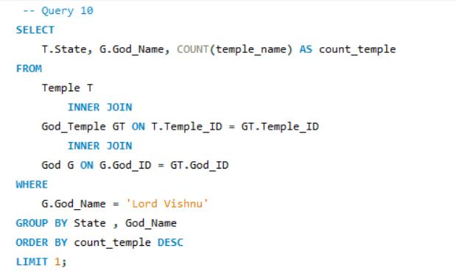
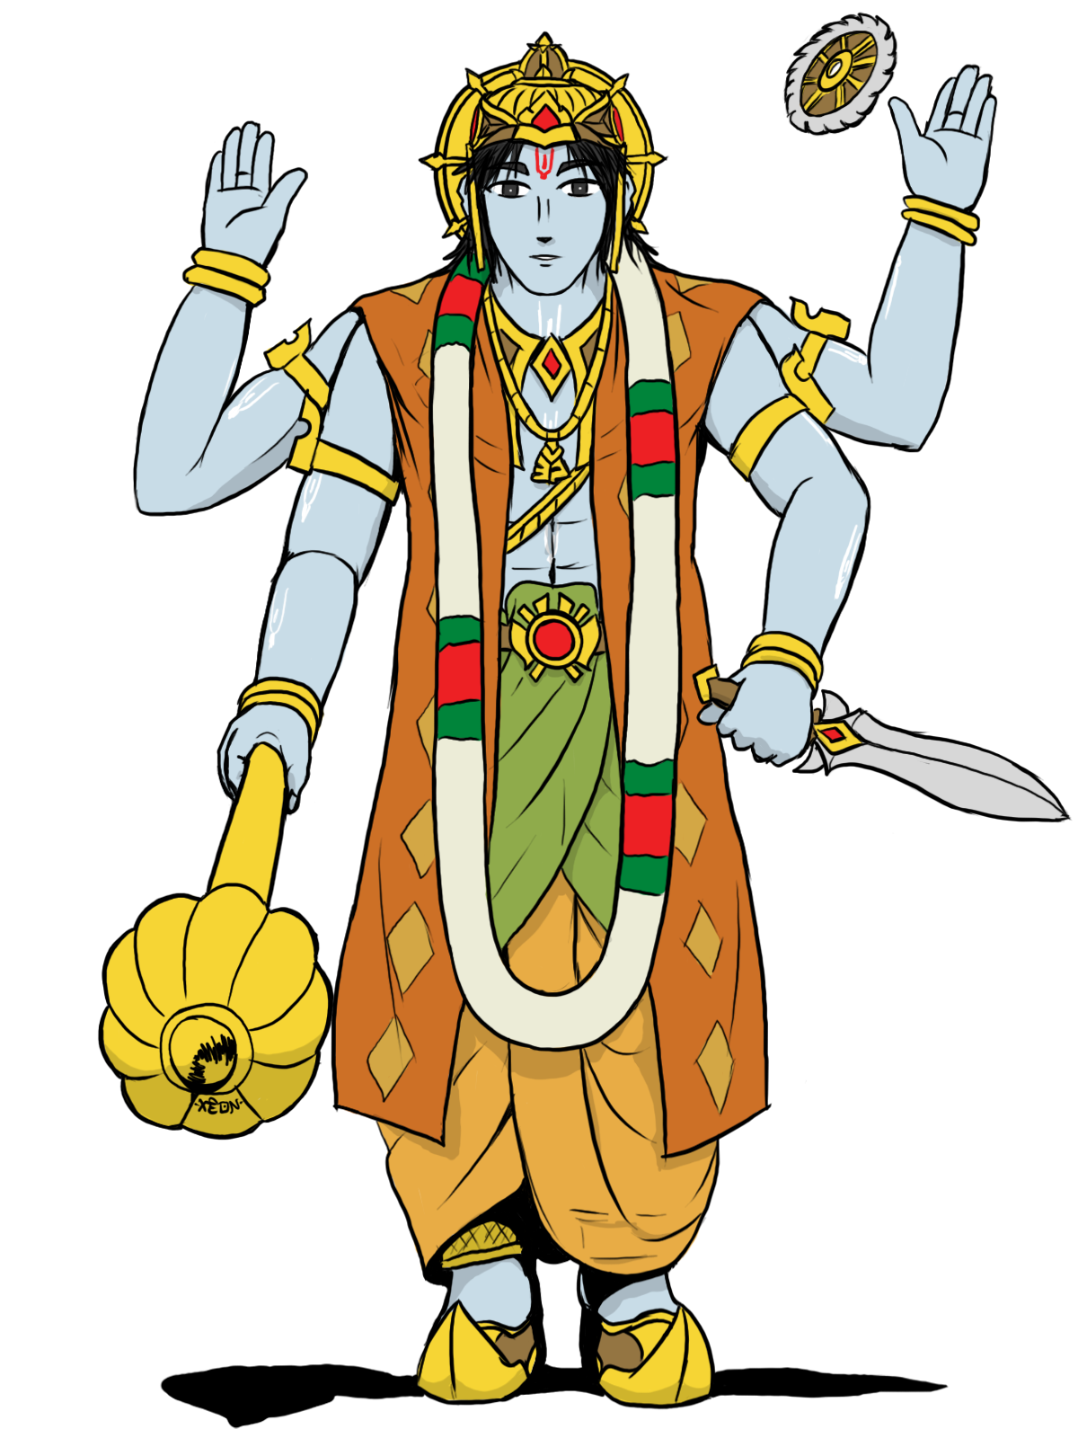
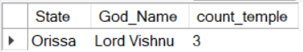
SQL Query 10 – Our traveller seems to be a devotee of “Lord Vishnu” and wants to know the state that has the most number of temples for the god “Lord Vishnu”
This query is designed for the devoted traveller of Lord Vishnu, aiming to uncover the Indian state with the greatest number of temples dedicated to "Lord Vishnu." By combining data from the "Temple," "God_Temple," and "God" tables through inner joins, the query counts the temples associated with this deity in each state. It then identifies the state with the highest temple count for "Lord Vishnu," allowing the traveller to plan a meaningful and spiritually enriching journey to a region known for its devotion to this revered god.

Slide 28
Thank You Q & A

